Slide 1
On-chip Detection Methodology for Break-Even Time of Power Gated Function Units Kimiyoshi Usami, Yuya Goto, Kensaku Matsunaga, Satoshi Koyama Shibaura
Instructor: Xuan-Tu Tran
Student: Kim Manh Cuong

Slide 2
Content
Introduction
Proposal Methodology
Results

Slide 3
Introduction
BET
Analytical models for the response of a leakage monitor and investigated the relationship to BET
BET of power-gated function units by using a leakage monitor

Slide 4
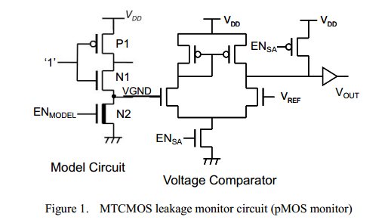
Proposal Methodology
MTCMOS LEAKAGE MONITOR
Analytical Model

Slide 5


Proposal Methodology
Q stored into the capacitance CVGND within delta t
time td as the time at which V reaches VREF
Detection Time Ratio (DTR) as the ratio of td at the absolute temperature T over td at the room temperature TRT

Slide 6

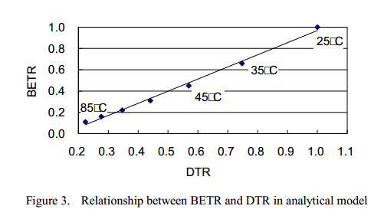
Proposal Methodology
Break-even time ratio BETR as the ratio of BET at T over BET at TRT
BETR increases almost linearly with DTR for the temperature range of 25θ C to 85θ C

Slide 7
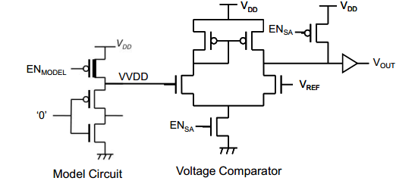
Proposal Methodology
nMOS Leakage Monitor

Slide 8
Proposal Methodology
II. Weighted Response of pMOS and nMOS Leakage Monitors
The shares of pMOS and nMOS leakage can be estimated by simulations for two process corners (FS and TT)

Slide 9


Proposal Methodology
leakage current for the FS corner
Solving these simultaneous equations, given:

Slide 10


Proposal Methodology
Use the weighted responses of pMOS and nMOS leakage monitors as a parameter to reflect the entire leakage of a function unit
leakage current flowing through turned-off pMOS at the room
temperature
The detection time of a leakage monitor at the room temperature

Slide 11

Proposal Methodology
BETnorm can be computed from the weighed response

Slide 12
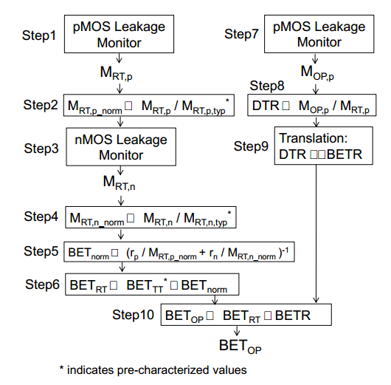
Proposal Methodology
III. METHODOLOGY FOR BET DETECTION

Slide 13
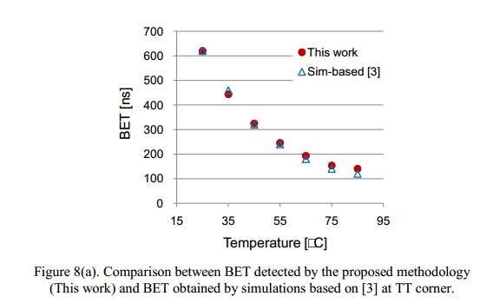
Results

Slide 14
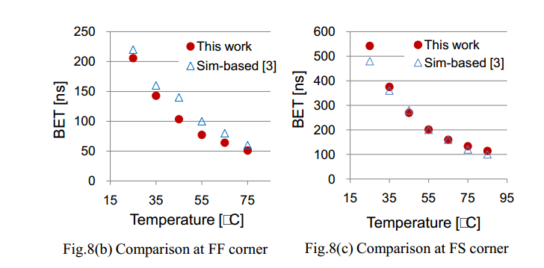
Results

Slide 15
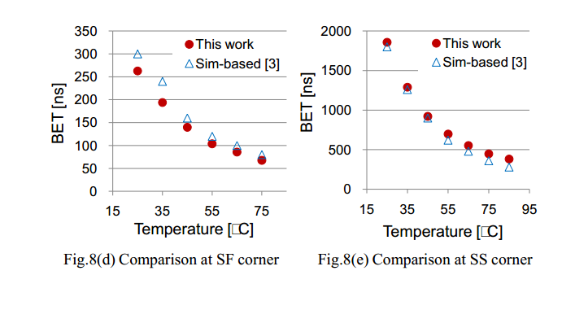
Results

Slide 16
Thanks for attention

